Slide 1
FULLSTACK ENGINEERING PROJECT
Tour Booking Application
Team No: 8
Group Details:
Lakshay 2210991839
Lakshey Asija 2210991843
Latika Bansal 2210991849
Llywellyn Sana 2210991854
Lovisha Goyal 2210991859
Supervised By:
Mr. Rahul Singh

Slide 2
Index
Introduction
Problem Statement
Solution
Key features
Project Workflow
Technology Used
UI Design
Benefits
Analysis
Conclusion

Slide 3


Introduction
Skyline Voyages is a tour booking application that makes planning your next adventure easy and enjoyable. With features like simple search options, clear tour details, and secure booking, it helps you find and book the perfect tour with just a few clicks.

Slide 4
Problem Statement
Problem: In today’s fast-paced world, booking and managing reservations for services such as travel, accommodations, and events can be time-consuming and complex. Users often face challenges with existing booking systems due to fragmented interfaces, limited accessibility, and lack of real-time updates . The current booking process is inefficient and fragmented, leading to a poor user experience. Customers often struggle with:
Inconsistent User Experience: Multiple platforms and interfaces create confusion and frustration.
Lack of Real-Time Availability: Users frequently encounter issues with outdated or inaccurate availability information.
Inefficient Communication: Users may face challenges with receiving timely updates or confirmations, which can result in missed appointments or reservations.

Slide 5
Solution
Roam Easy solves these problems by offering an easy and straightforward way to find and book great tours.
Easy Booking
Clear Information:
Customized Options
Get all the details you need about tours, like prices, schedules, and reviews, so you know exactly what to expect.
Choose tours that fit your interests by picking your favourite activities, destinations, and dates.
Finding and booking tours is quick and simple with Roam Easy, making the process hassle-free.

Slide 6
Key features
Sign-Up/Login : Allow users to create accounts and log in.
Profile Management: Users can update personal information, view booking history.
Search Functionality: Users can search for tours based on destination, date, duration, type of tour, and other filters.
Tour Descriptions: Provide complete details about each tour.
Admin: This is an additional feature available only for the admin
Analysis: Provide the analysis for the admin
Real-Time Availability: Show live availability of tours and slots.

Slide 7
Key features
Multiple Payment Options: Support various payment methods including credit/debit cards , UPI , and digital wallets.
Customization option: Allow users to customize tours , flight tickets , hotel.
Travel Services Integration: Connect with flight and accommodation providers for complete travel packages.
Live Weather: featuring live weather updates for your chosen destination!

Slide 8
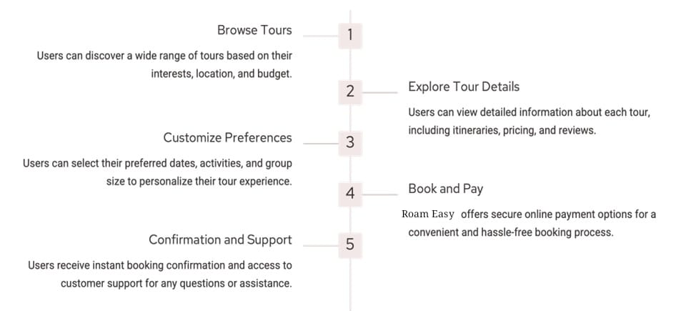

Project Workflow

Slide 9



Technology Used
Frontend: HTML, CSS, ReactJs, JavaScript.
Backend: NodeJS, Express, Mongoose .
Database: MongoDB.
IDE: Visual Studio Code (VS Code).

Slide 10
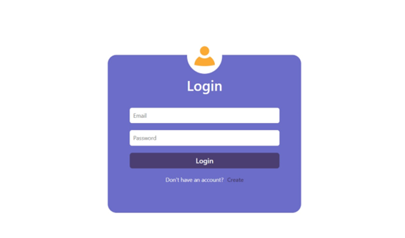
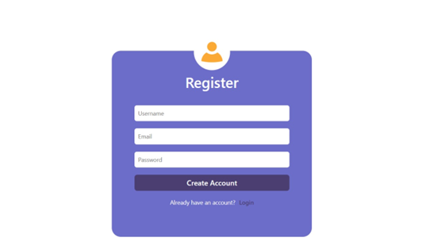

UI Design

Slide 11
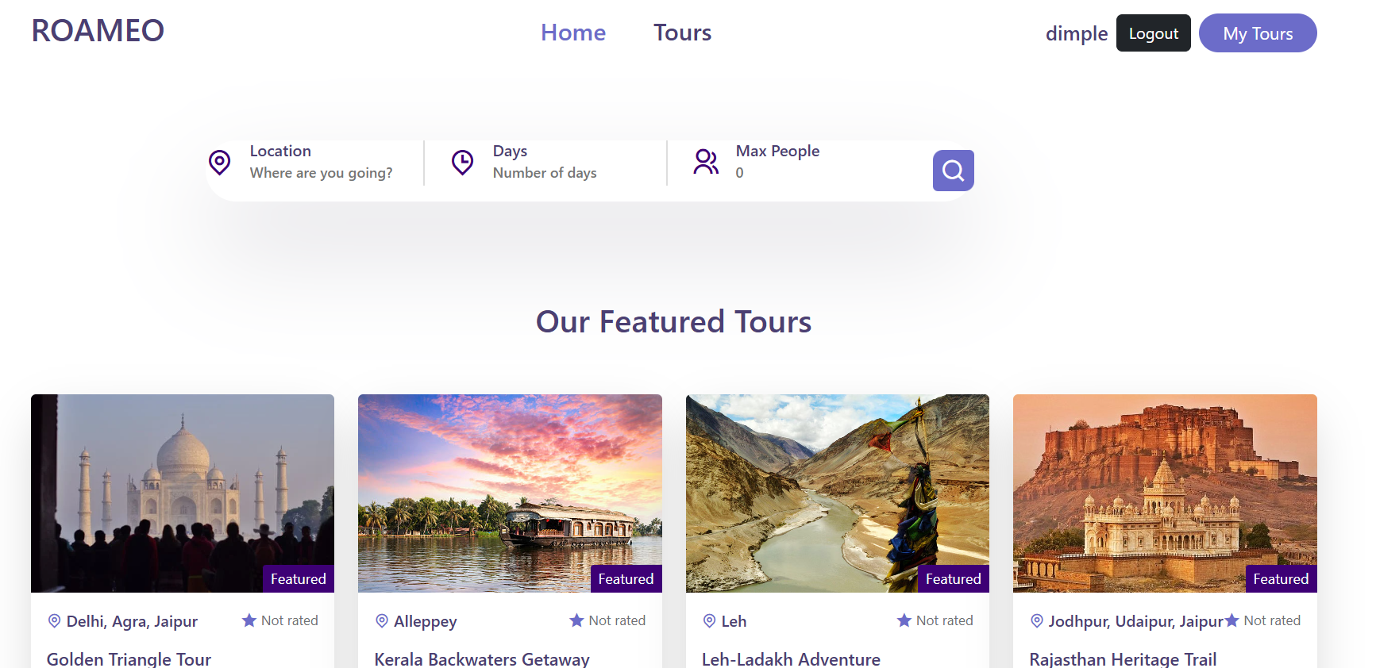
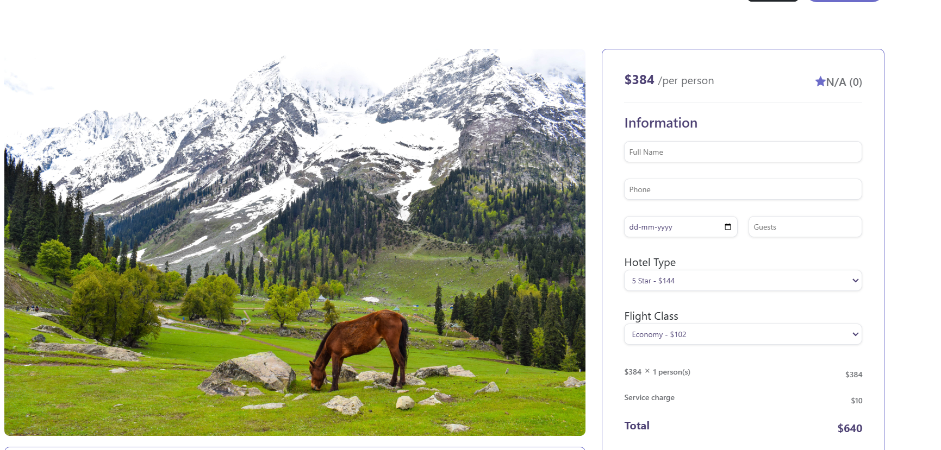
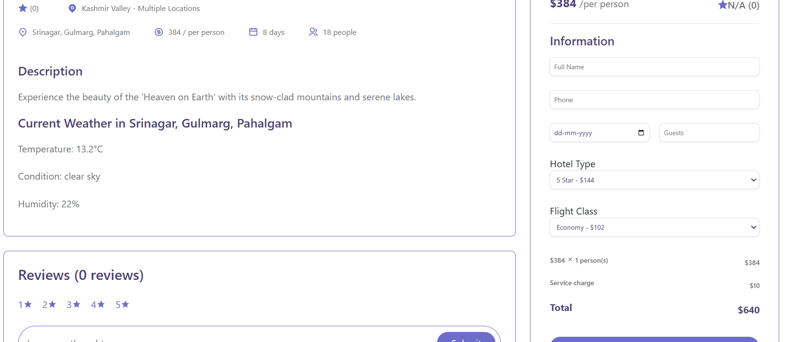

UI Design

Slide 12

UI Design

Slide 13

UI Design

Slide 14
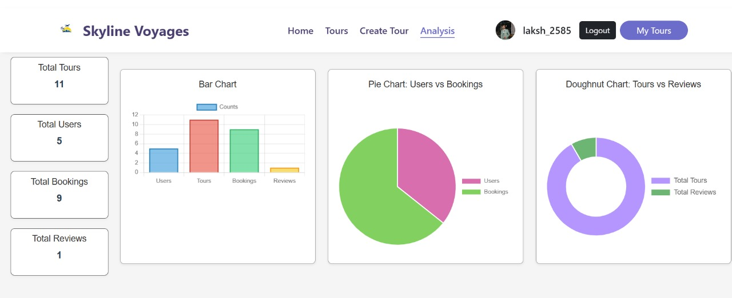
UI Design

Slide 15
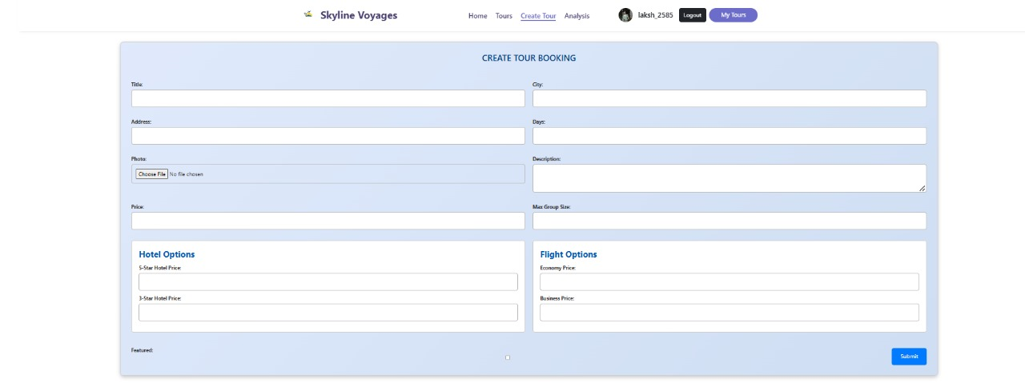
UI Design

Slide 16
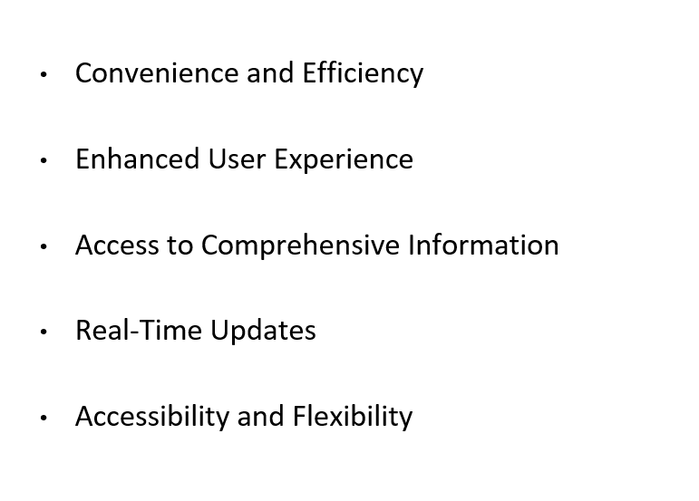
Benefits

Slide 17
Benefits
Admin Interface: Only admin can register this and a tour can be created
Analysis: This additional feature manage the users , registrations ad tours count.

Slide 18
Conclusion
The tour booking application represents a significant step forward in addressing the inefficiencies and challenges of current booking systems. By focusing on user needs, integrating comprehensive features, and ensuring operational efficiency, the application is well-positioned to deliver a superior booking experience, foster customer satisfaction, and support the growth of tour operators. The successful implementation of these features will not only enhance the convenience and effectiveness of booking tours but also set a new standard in the travel and tourism industry.

Slide 19
Thank you

